Slide 1

EU SUPPORT TO HIGHER EDUCATION
IN ASEAN REGION PROGRAMME
EU SHARE
Darren McDermott – SHARE Team Leader Designate

Slide 2

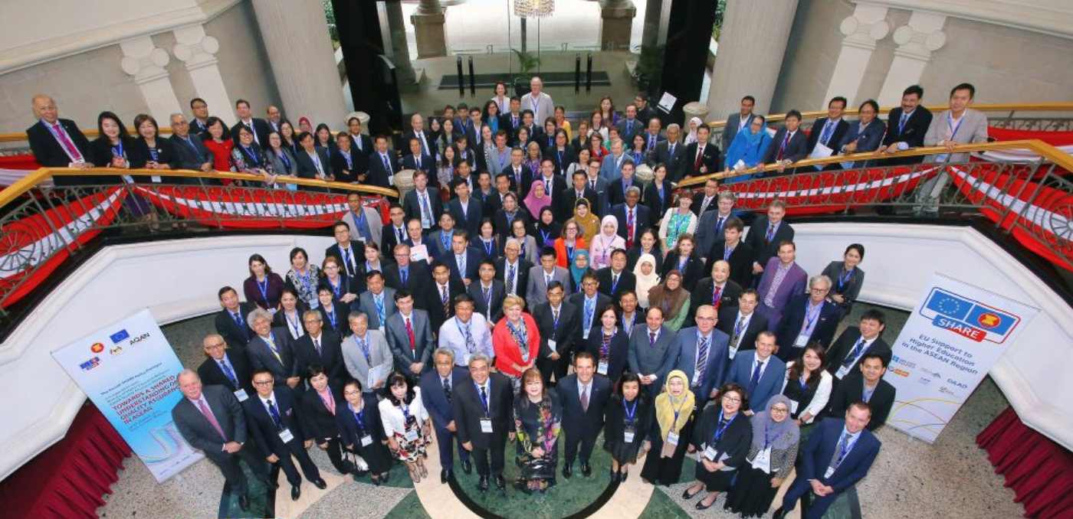


Slide 3
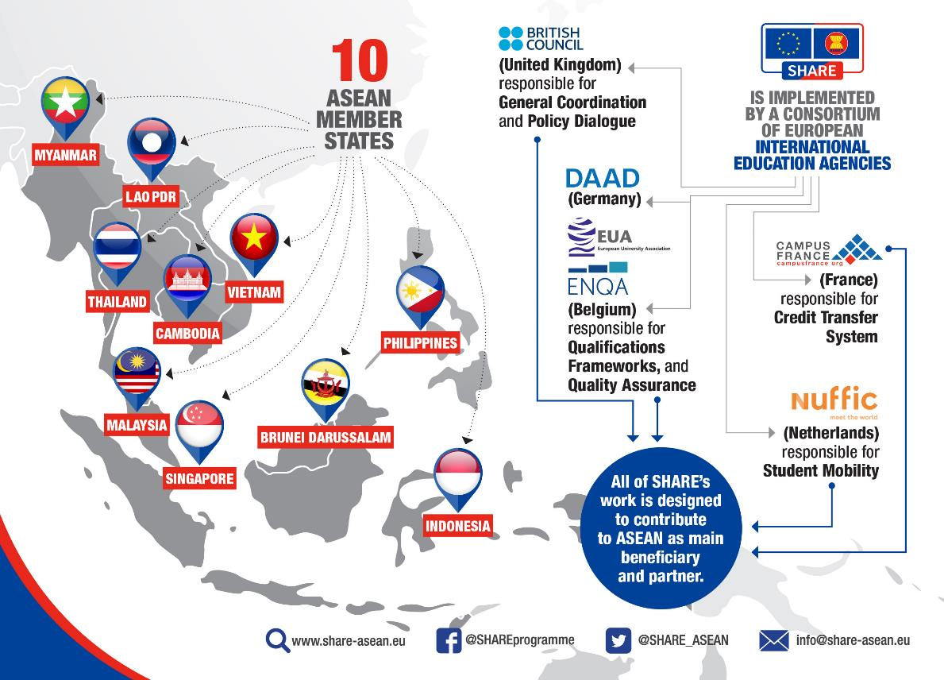
OBJECTIVES
Enhance the harmonisation of ASEAN Higher Education Area through the development of ASEAN Higher Education frameworks
Support mutual recognition and student mobility among HEIs in ASEAN to strengthen people-to-people connectivity
Serve as platform to connect policy-university-students in regional HE
Support strengthening of ASEAN identity among future graduates through regional mobility (Erasmus effect)

Slide 4
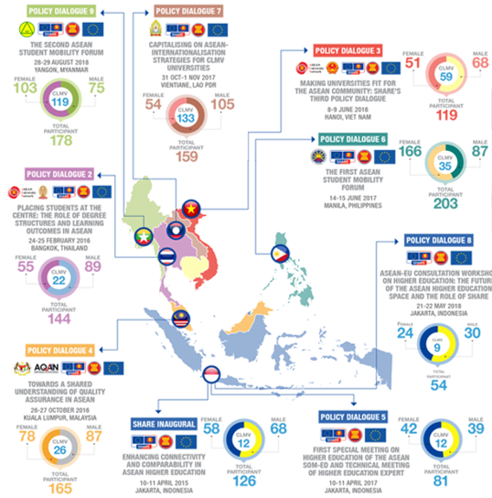
Result Area 1: Policy Dialogue
What is Policy Dialogue?
A platform to discuss all policy and technical issues between stakeholders
Why is it important?
An opportunity to share experience, generate debate, influence policy changes, and respond to requests and movements in the ASEAN Higher Education landscape
Who we work with?
ASEC, EUD, SOM-ED, AUN, SEAMEO-RIHED, AQAN, other Dialogue Partners, Higher Education Institutions, Students

Slide 5
Result Area 2ab: Qualifications Frameworks & Quality Assurance
2a: ASEAN Qualifications Reference Frameworks
Reviewing the implications of the AQRF for Higher Education
Strengthening institutional capacities to develop National Qualifications Frameworks (NQFs) using the AQRF
Supporting the dissemination of the AQRF and the alignment of NQFs
2b: ASEAN Quality Assurance Frameworks
QA Capacity Development for staff of HEIs and QA Assessors
Supporting the development, alignment and dissemination of the AQAF

Slide 6
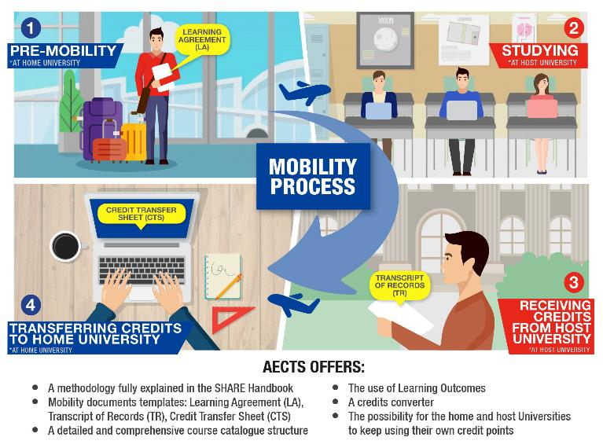
Result Area 3ab: Credit Transfer System
Credit Transfer Systems Outcomes
Establish a detailed overview of users’ (HEI, students) needs
Build sustainable and user-friendly mobility tools
Enhance the capacity on the use of online tool(s)
Ensure the ownership of the platform and other mobility tools by main stakeholders
Improve the approach of intra-ASEAN and EU-ASEAN student mobility among HEI, regional stakeholders and students

Slide 7
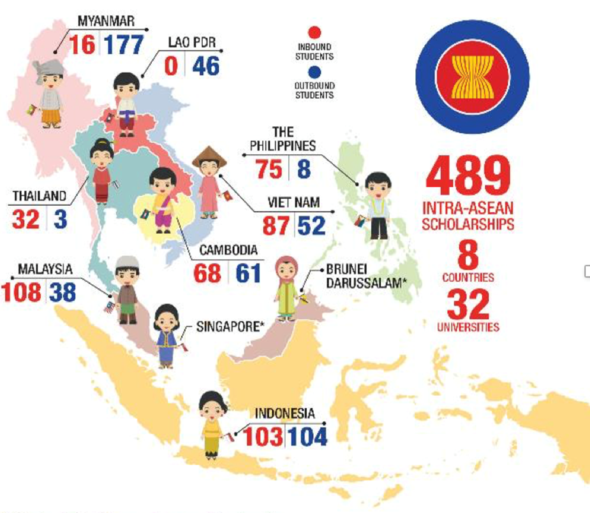
Result Area 3c: Intra-ASEAN Student Mobility Scholarship
SHARE Scholarship Outcomes
Test the outcomes of SHARE through a scholarship programme that addresses student mobility issues
The scholarship programme will provide direct feedback for further progress of other key result areas
Build on existing regional scholarship initiatives: ASEAN (AUN-ACTS) and SEAMEO (AIMS)
Contribute to the development of a pan-ASEAN, single-branded scholarship

Slide 8
32 PARTICIPATING ASEAN UNIVERSITIES
CAMBODIA
Universiti Malaysia Sabah
Universiti Teknologi Malaysia
Taylor’s University Malaysia
Universiti Kebangsaan Malaysia
MALAYSIA
National University of Laos
LAO PDR
Bina Nusantara University
Bogor Agricultural University
Universitas Diponegoro
Universitas Indonesia
INDONESIA
National University of Management Cambodia
Phnom Penh International University
University of Cambodia
Royal University of Phnom Penh
Souphanouvong University
Champasak University
Savannakhet University

Slide 9
32 PARTICIPATING ASEAN UNIVERSITIES
MYANMAR
University of Yangon
VIET NAM
Viet Nam National University
PHILIPPINES
THAILAND
University of the Philippines
Chulalongkorn University
Mandalay University
Myanmar Maritime University
Yangon University of Economics
University of Santo Tomas
De La Salle University
Ateneo de Manila University
Payap University
King Mongkut’s University of Technology Thonburi
Thammasat University
Hanoi University of Science and Technology
Ho Chi Minh University of Technology and Education
Hue University

Slide 10
ELIGIBILITY CRITERIA
Nationals of ASEAN Member States*
Undergraduate students of ASEAN participating university
Completed at least 2 semesters at home university
*Students from Singapore and Brunei Darussalam can also participate using the scholarships from their universities or government

Slide 11
SHARE SCHOLARSHIP APPLICATION PROCESS
1
Applicant receives endorsement from home university
2
Applicant applies to host university
3
Receives Letter of Acceptance (LoA) from host university
4
Applies for SHARE Scholarship
5
Selection of Awardees by the SHARE Scholarship Team
6
SHARE Scholarship awarded

Slide 12
SCHOLARSHIP COVERAGE
Visa costs
Return airfare (international and domestic)
Settling-in allowance
Tuition fees (waived)
Living allowance
Health insurance
Study materials

Slide 13
Thank you for your kind attention!
Your questions are welcome.

